Slide 1
Chameleon Service Training
Dieburg, 06.-10.06.2016
System Installation

Slide 2
Overview
Preparation
Equipment
Installation Procedure
Acceptance Test
Customer Training

Slide 3
Preparation
Check, if
Laser Crate, MRU, Chiller & CoolFlow Packages were delivered
Check shock and tilt sensors
Acclimatisation / bring in lab
Lab ready?
Optics table
Electricity: number of wall plugs / multiple plug socket
Laser safety installations
Clean / dust-free floor

Slide 4
Equipment
Personal Safety Glasses
Notebook, GUI installed and tested
REES!
Oscilloscope (recommendation: > 100MHz, Tektronix)
Powermeter(s) (LM-10 & LM-45 for Verdi calibration)
Fiber Scope
DVM
DC Current Clamp
IR Viewer / IR Card
Fast Photocell (Thorlabs DET10 A/M)

Slide 5
Tools
Chameleon Pick-off Mirror, PN#1058622
Fiber Cleaning Supplies ➔ Video
ESD Wrist Strap!
Cables
USB Cable, Type A-A
RS-232 Cable
USB-RS232 Adapter
BNC Cable
Standard Tools like allen wrenges, screw drivers, M6 screws,…

Slide 6
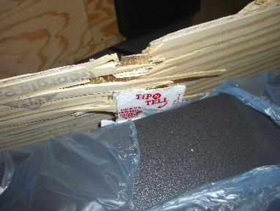
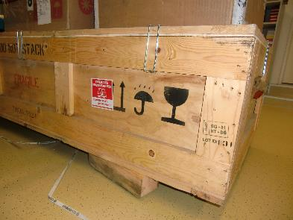
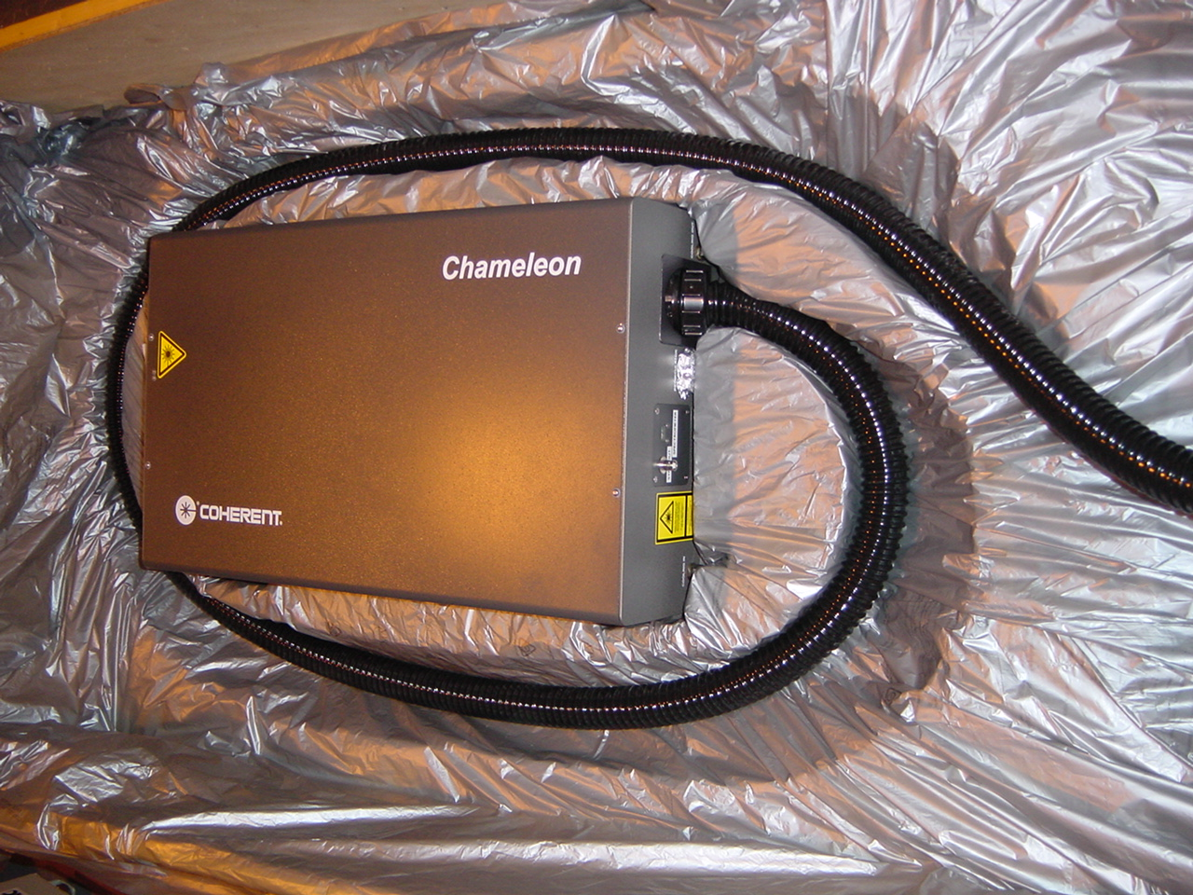
Installation Procedure
Shipment Inspection
Outside appearance, take pictures of damages, report to Coherent if needed
Check if shipment is complete
Unpacking Head & PSU together
Minimum of two people for lifting
Apply back-gentle movements: 52kg
Do not disconnect fibers from PSU!!
Connect all cables
MRU cable: press hard until it clicks
Chiller: Cooling flow direction important
Check lab voltage & compare with PSU fuses

Slide 7
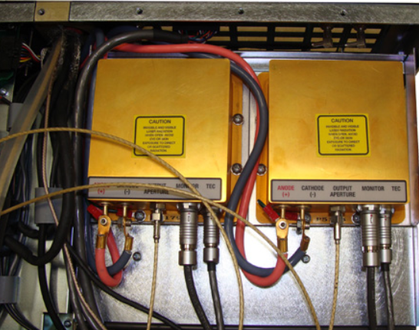
Installation Procedure
Check proper seating of „Fiber Cable Ferrule Nut“
PN# 0170-839-00
Ground yourself first.

Slide 8
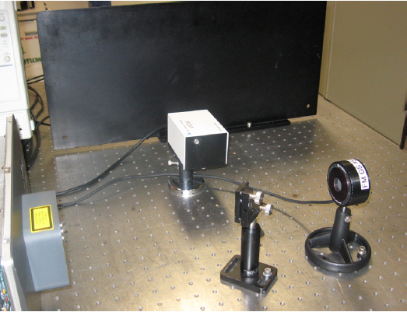
Installation Procedure
Install Measurement Equipment
Turn on Laser after Warm-up
Perform Wavelength Sweep
Record & Safe Datalog file
Record & Safe EEPROM data

Slide 9
Installation Procedure
EEPROM Data / Calibration Table

Slide 10
Installation Procedure
Tuning Calibration
During manufacture, Chameleon is calibrated at 41 equally spaced wavelength points across the tuning range.
System calibration should be valid for the lifetime of the laser.
Recalibration in the field should only be carried out following appropriate investigation of potential fault areas.
Re-calibration by trained service engineer only !

Slide 11
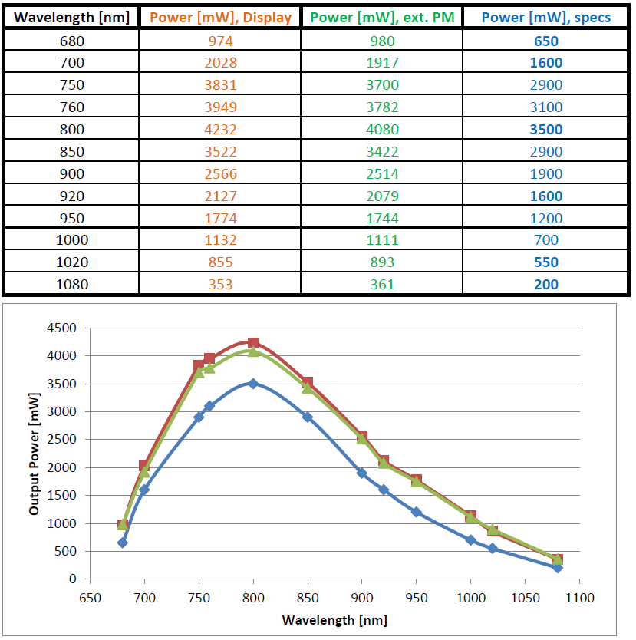
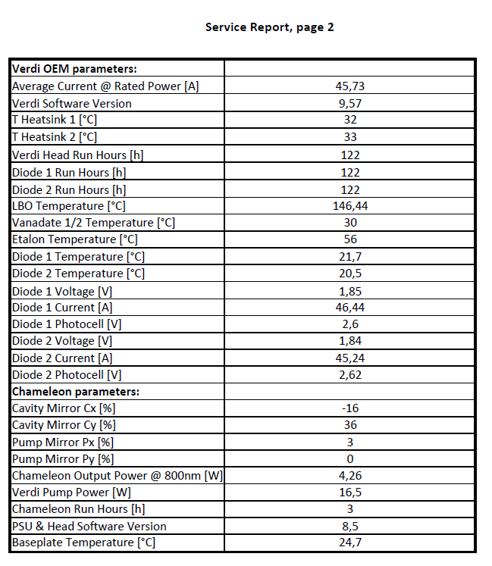
Acceptance Test
Check proper pulse quality & power level across full tuning range
Record „power versus wavelength“ data in installation report
Compare with specification

Slide 12
Customer Training & Closure
Inform customer about
Laser beam properties & Laser safety
Turn-On & Off Procedures
required, regular maintenance
If required, install GUI on customer PC
Explain Remote Session
On-site measurements and performance of this unit
Show customer proper filled installation report and let him sign
Send signed installation report to Coherent Tech Support Team

Slide 13
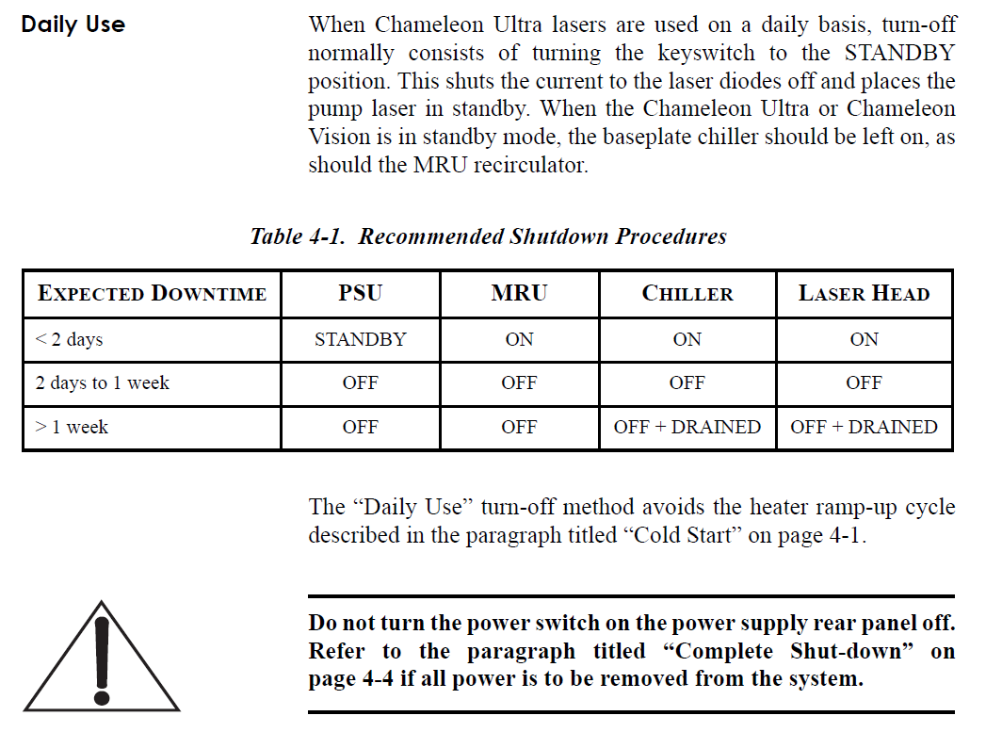
Turn-On and Off Procedures

Slide 14
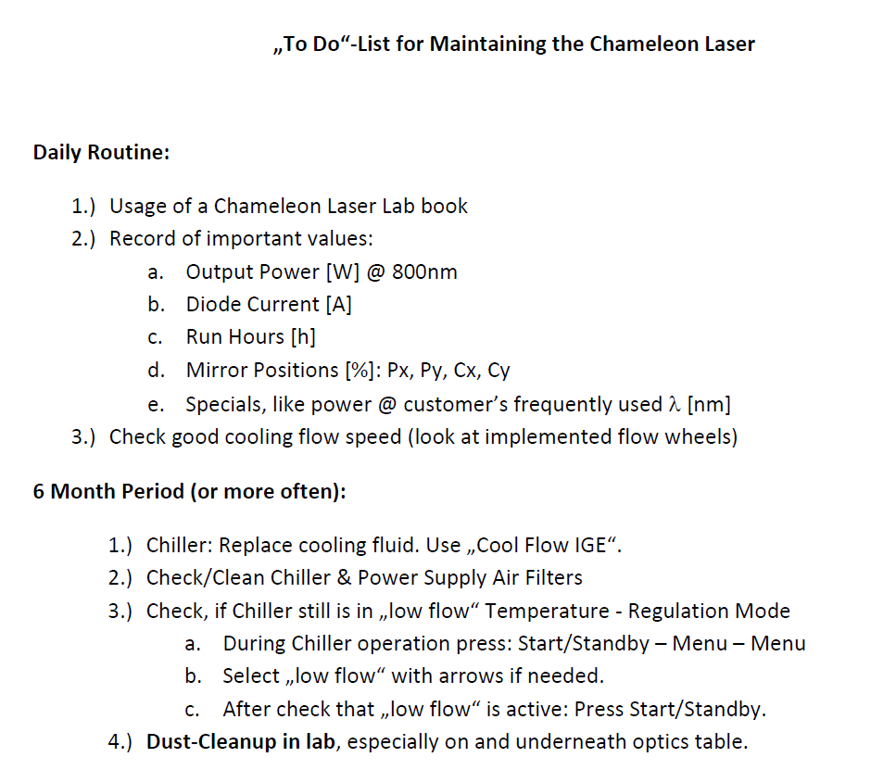
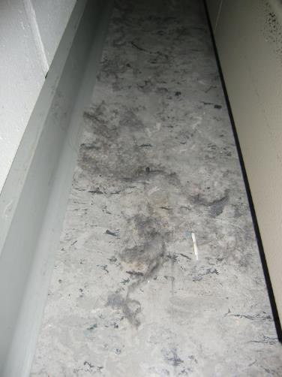
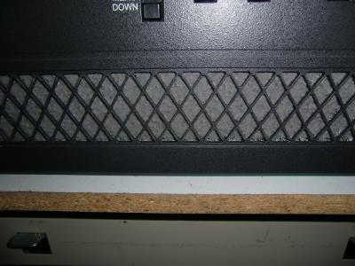
Customer Maintenance

Slide 15
Still some time and energy ???

Slide 16
Inform customer about:
Service Strategy &
LMC Advantages

Slide 17
Technical Support Hotline
All technical questions can be applied to our Inhouse Support Team
Phone +49 6071 968-225
E-Mail service.dieburg@coherent.com
Or to you: Leave your business card on the optics table ;-)

Slide 18
In case of an issue: Our Service Strategy
Within 12 months after installation
+ 1 month integration time
Warranty
Beyond 12 months:
Customer buys warranty extention, or
Paid Service: Service visit & parts will be charged on event basis
NO ARU program!
Depot Repair costs are between 6,5k€ (minor) – 32,5k€ (Verdi repl.), or
Even higher, if several issues have been found
Full Depot Repair Time approx. 6-10 weeks

Slide 19
Service Strategy
Warranty Extention
Name: Productivity Plus (P-Plus)
Free of charge Remote Session per Bomgar / TeamViewer
Parts & Field Visit Costs inclusive
Preferred Reaction Time
Minimum Downtime
ARU Program
Important Requirement:
Laser has to be in specification before it can join P-Plus.

Slide 20
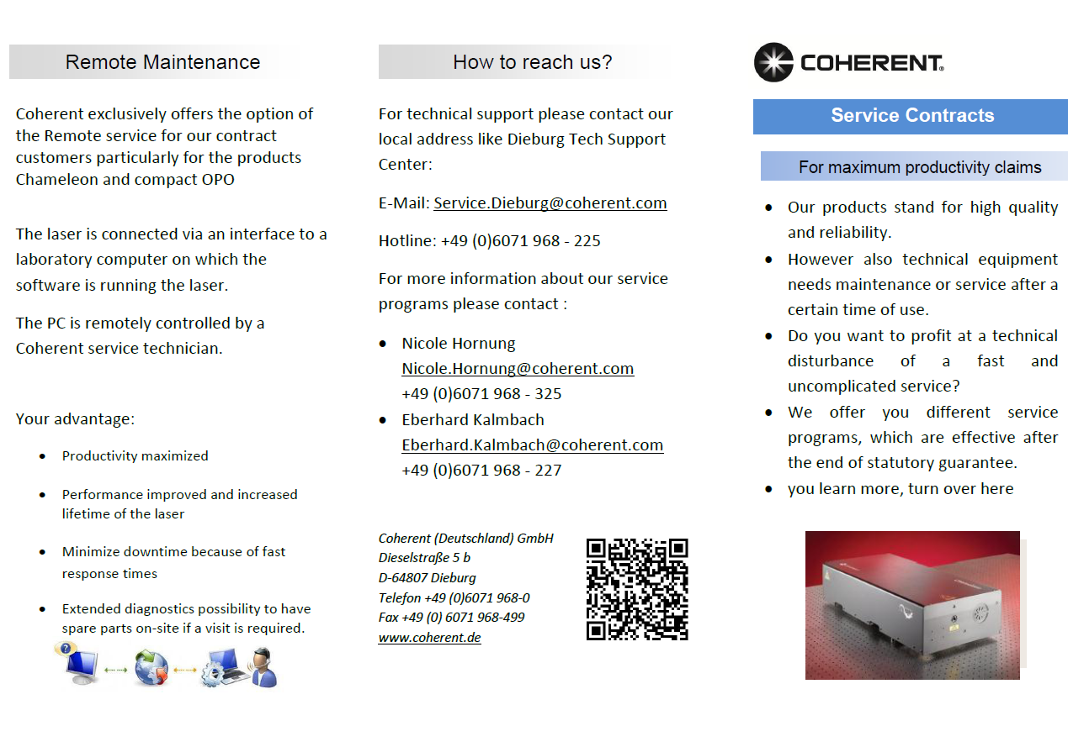
Service Strategy: P-Plus – Flyer 1/2

Slide 21
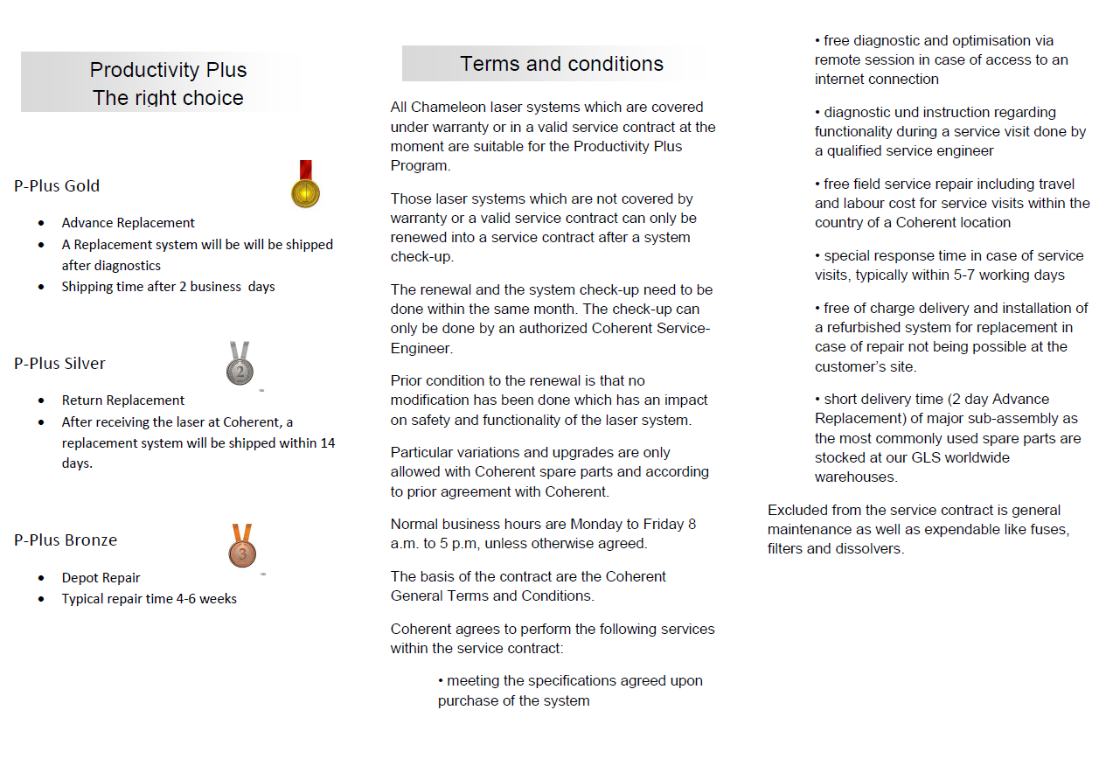
Service Strategy: P-Plus – Flyer 2/2

Slide 22
Service Strategy / P-Plus Matrix
 | Chameleon
System Lifetime Period | Warranty | Out of Warranty | Service Contract
 | 12 (24) months | > 12 (24) months
Plan | Option
Depot Repair Repaired system returned typically 4-6 weeks after receipt at Coherent | Not Applicable | Standard (Paid) | PPlus Bronze
Return Replacement Replacement system ships within 15 business days | Not Applicable | Not Applicable | PPlus Silver
Advance Replacement Ship from GLS within 2 working days (for 90% of all events) after customer informs of failed system | Standard (Free of Charge) | Not Applicable | PPlus Gold

Slide 23
Inform customer about LMC: Laser Measurement & Control short: Powermeters
LMC Price Advantages
Leave LMC Flyer &
Send LMC catalogue
Or give Link to Coherent website:
https://www.coherent.com/products/?1940/Laser-Measurement-and-Control-Literature

Slide 24


Now, let’s do the first Quiz…

Slide 25
Some Info's about the daily Quiz
Altogether four quizzes of the course
To pass a quiz, you need > 60%
To get an A+, you need 100%
With bonus questions, you can achieve >100%
These questions are sophisticated, a little mean, but always related to Chameleon ;-)
Free internet allowed, but please try to find the answers yourself.

